Slide 1



From Complexity to Knowledge: Advanced Environmental Sample Analysis
Caroline Gauchotte-Lindsay
hiRACE
Infrastructure and Environment
James Watt School of Engineering-
University of Glasgow
caroline.gauchotte-lindsay@glasgow.ac.uk

Slide 2
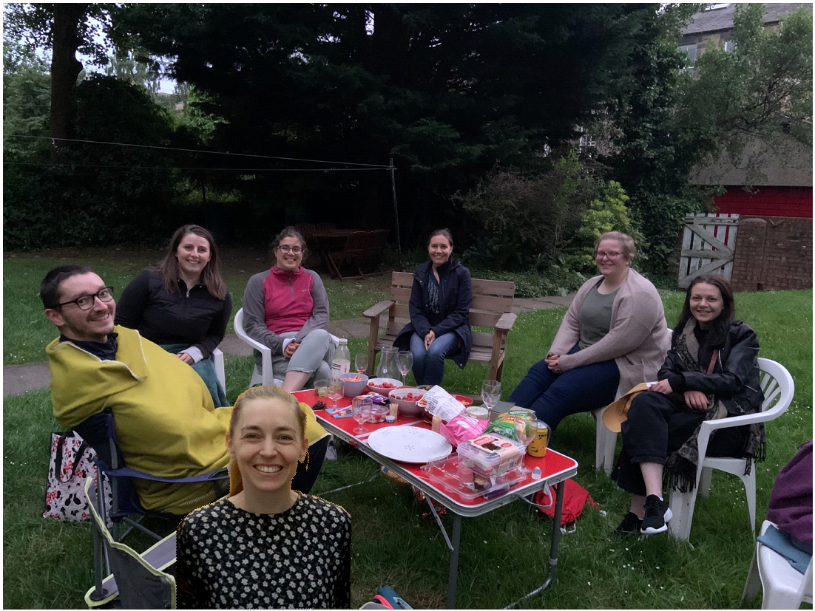







Acknowledgments
Collaborators on the presented projects
Dr Umer Ijaz,
Dr Justin Sperling,
Dr William Peverl,
Professor Alasdair Clark
University of Glasgow
Mara Knapp- University of Strathclyde
Dr Kryzstof Kapusta- GIG, Poland
Prof John Langley- University of Southampton
Dr Juan Ye- University of St Andrews
Funders
Former members
Dr Jeanine Lenselink
Dr Kate Fell
Dr Mark Stillings
Dr Ioannis Sampsonidis
Dr Ili Farhana Binti Mohamad Ali Nasri
Dr Celeste Felion
Dr Franziska Tuerk
Dr Elmira Khaskar Najafi
Dr Anca Amariei
Dr Maricela Blair
Dr Felipe Sepulveda Olea
Dr Kevin Bayle
Dr Carla Cebula
Dr Julie Jebsen
Mircea Martiniuc
Dr Laurie Savage
hiRACE Lab-
Current members
Sophie Singer
Madelyn Murphy
Ali Swedan
Victor Baridom Giador
Dr Carla Comadran Casas
Dr Baptise Poursat
Leco- Alan Griffiths, Nick Jones
Scottish Water- Graeme Moore
ERS- Tom Aspray
Spraying Systems Co.-Rudi Schick,
Chad Sipperley

Slide 3
Signature-based analysis for environmental engineering systems
Environmental engineering systems are chemically complex and dynamic
Targeted analyses often miss system-level behaviour
Signature analysis and multivariate methods reveal hidden structure
Monitoring, describing, predicting and engineering become more efficient

Slide 4
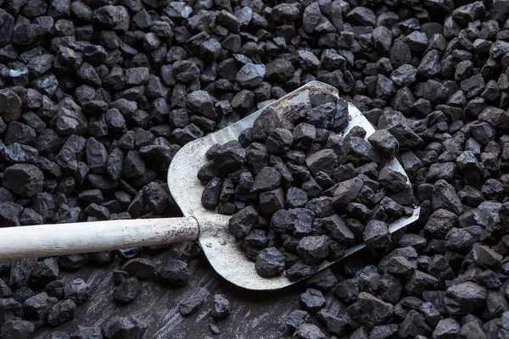
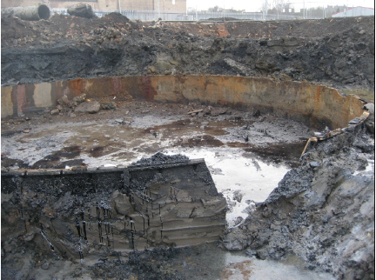
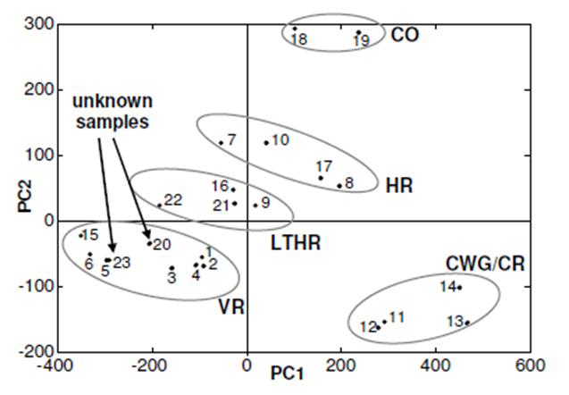
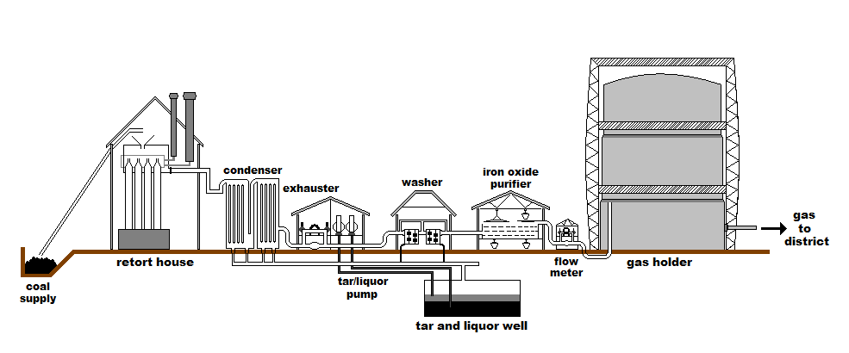
Manufactured Gas Plant
Coal
Tar
Derivatised
Process | Abrev. | Tar Composition
Vertical retort | VR | Lower naphthalene content than horizontals, but higher abundance of tar acids
Low temperature horizontal retort | LTHR | High content of low molecular weight volatiles e.g. paraffins, olefins, phenols, but low carbazole content
High temperature horizontal retort | HR | Rich in aromatics, high toluene and carbazole, low creosote/anthracene fraction and trace aliphatic content.
Carburetted water gas | CWG | Very low naphthalene and phenols content, aliphatics always present
Creosote | CR | Tar distillates between 200 and 400̊C- Aromatics and tar acids.
Coke oven | CO | High PAH content, low in N-containing heterocycles, acids and aliphatics.
Unsupervised multivariate analysis
McGregor et al./ES&T, 46 (2012)

Slide 5
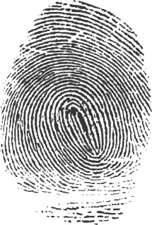
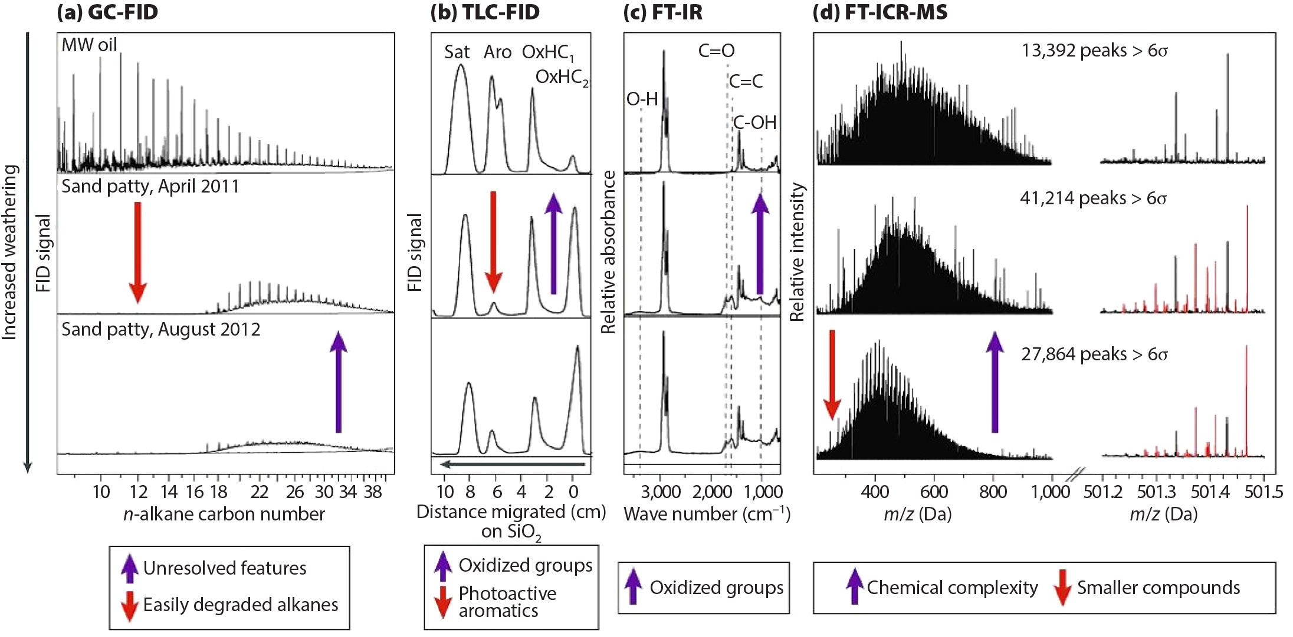
Environmental Chemical Fingerprint ?

Slide 6
Environmental Chemical Fingerprint ?

Slide 7
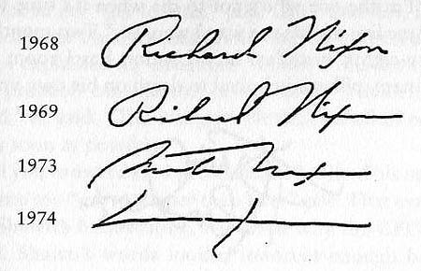
Environmental Chemical Signatures

Slide 8
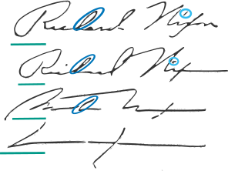
Environmental Chemical Signatures
Increased weathering

Slide 9
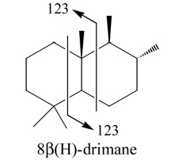

Environmental Chemical Signatures Targeted analysis

Slide 10
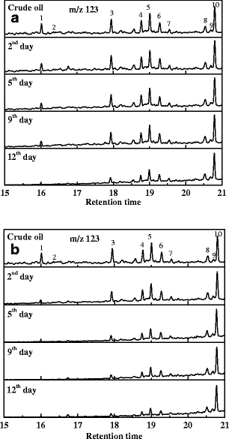
Environmental Chemical Signatures Targeted analysis

Slide 11
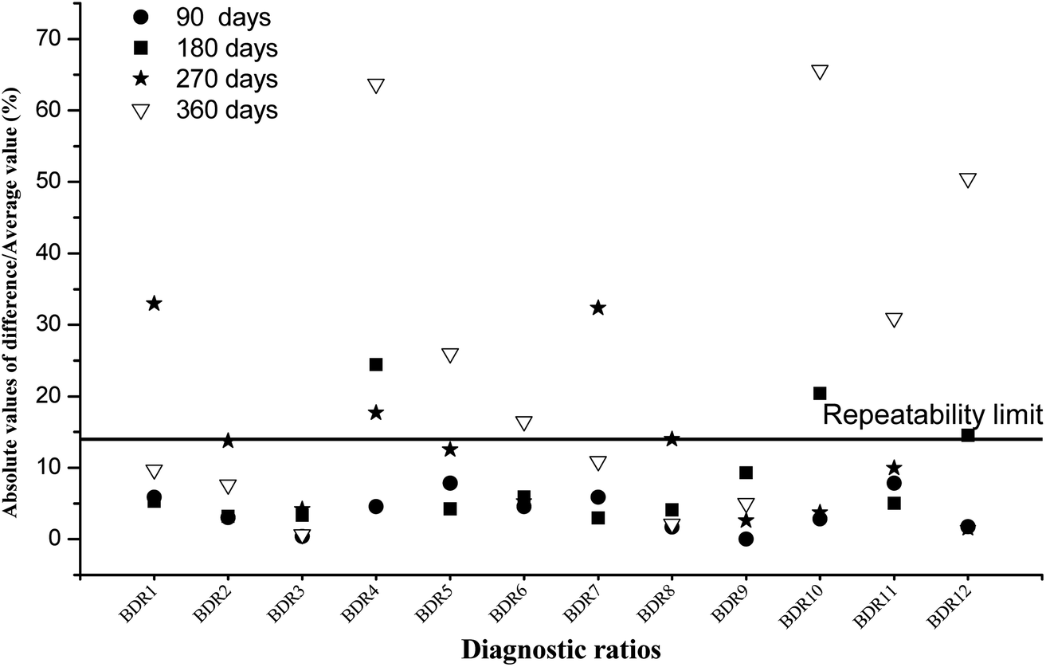
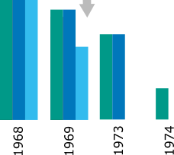
Environmental Chemical Signatures Targeted analysis

Slide 12
Environmental Chemical Signatures Non-Targeted analysis

Slide 13
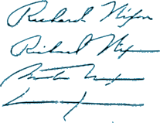
Environmental Chemical Signatures Non-Targeted analysis

Slide 14
Environmental Chemical Signatures Non-Targeted analysis

Slide 15
Environmental Chemical Signatures Non-Targeted analysis

Slide 16
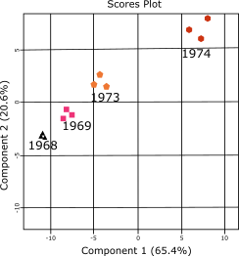
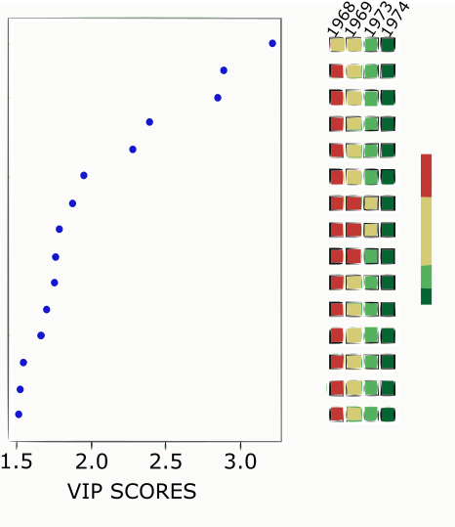
Environmental Chemical Signatures Non-Targeted analysis

Slide 17

Environmental Chemical Signatures Non-Targeted analysis

Slide 18
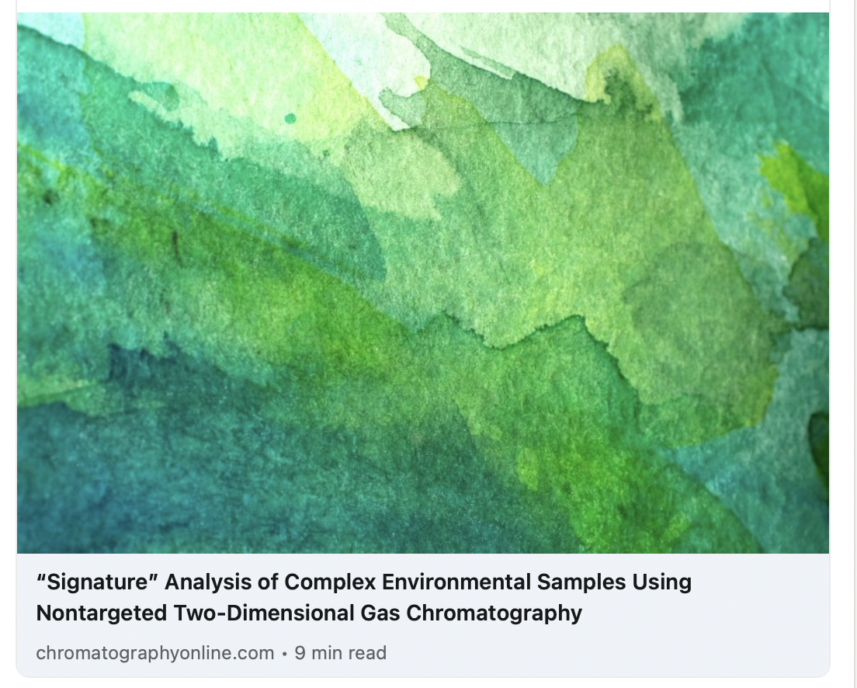
Environmental Chemical Signatures Non-Targeted analysis

Slide 19
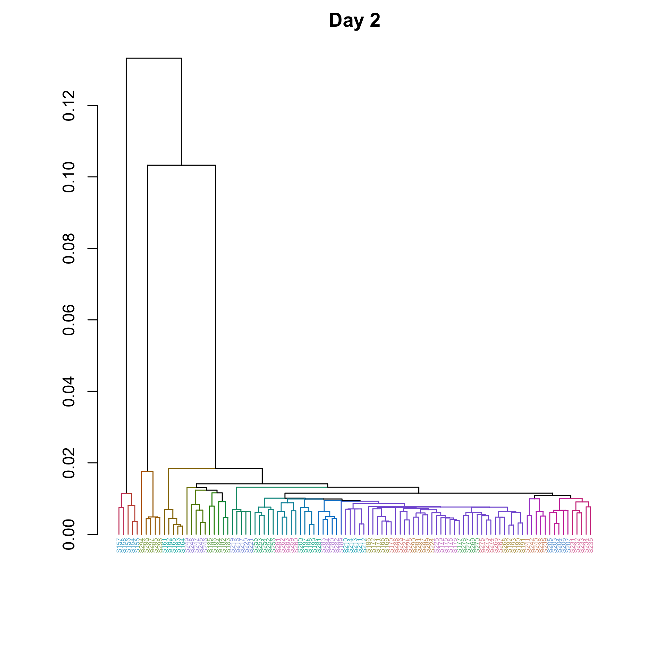
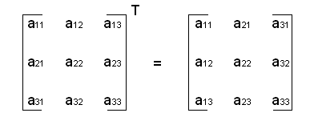
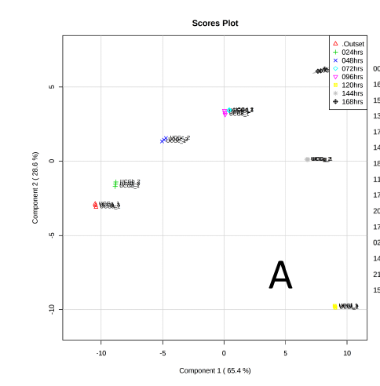
Multivariate Analysis for Interpretation
Features
Samples
Hierarchical clustering
PCA- unsupervised
Correlation matrix
HC Heatmap/Clustergram
PLS-DA- supervised

Slide 20
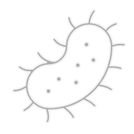
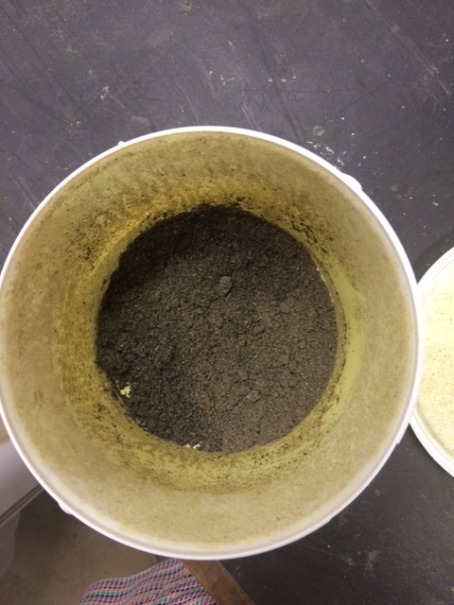
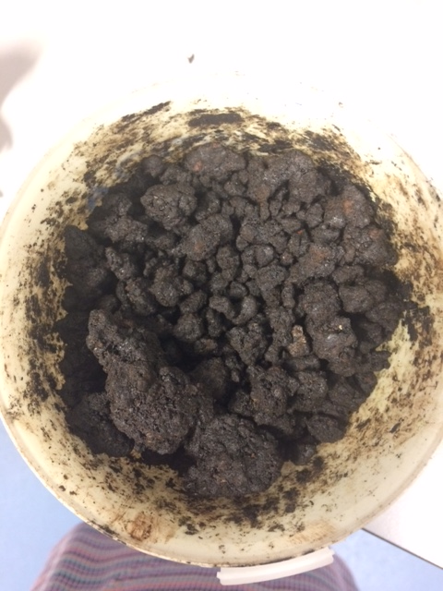
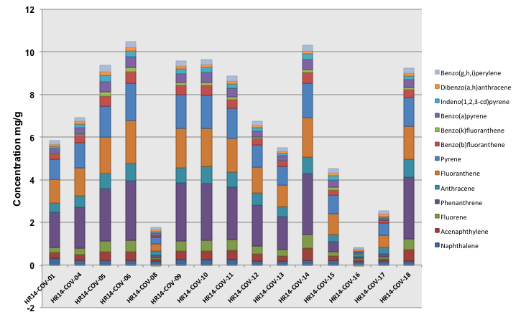
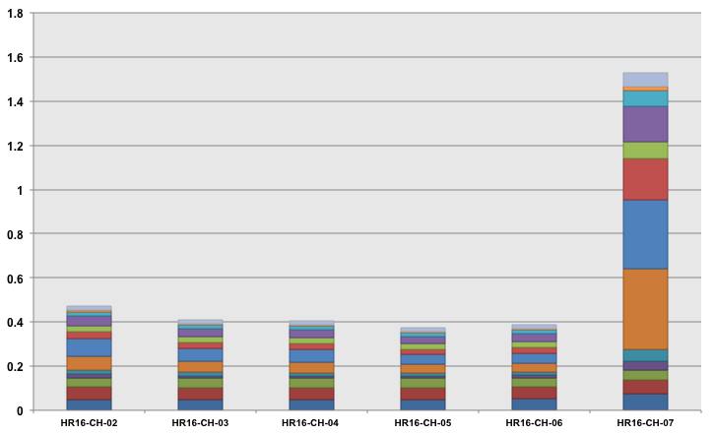
Tar
Microbial
Degradation
Polycyclic aromatic hydrocarbons
COV
CH

Slide 21
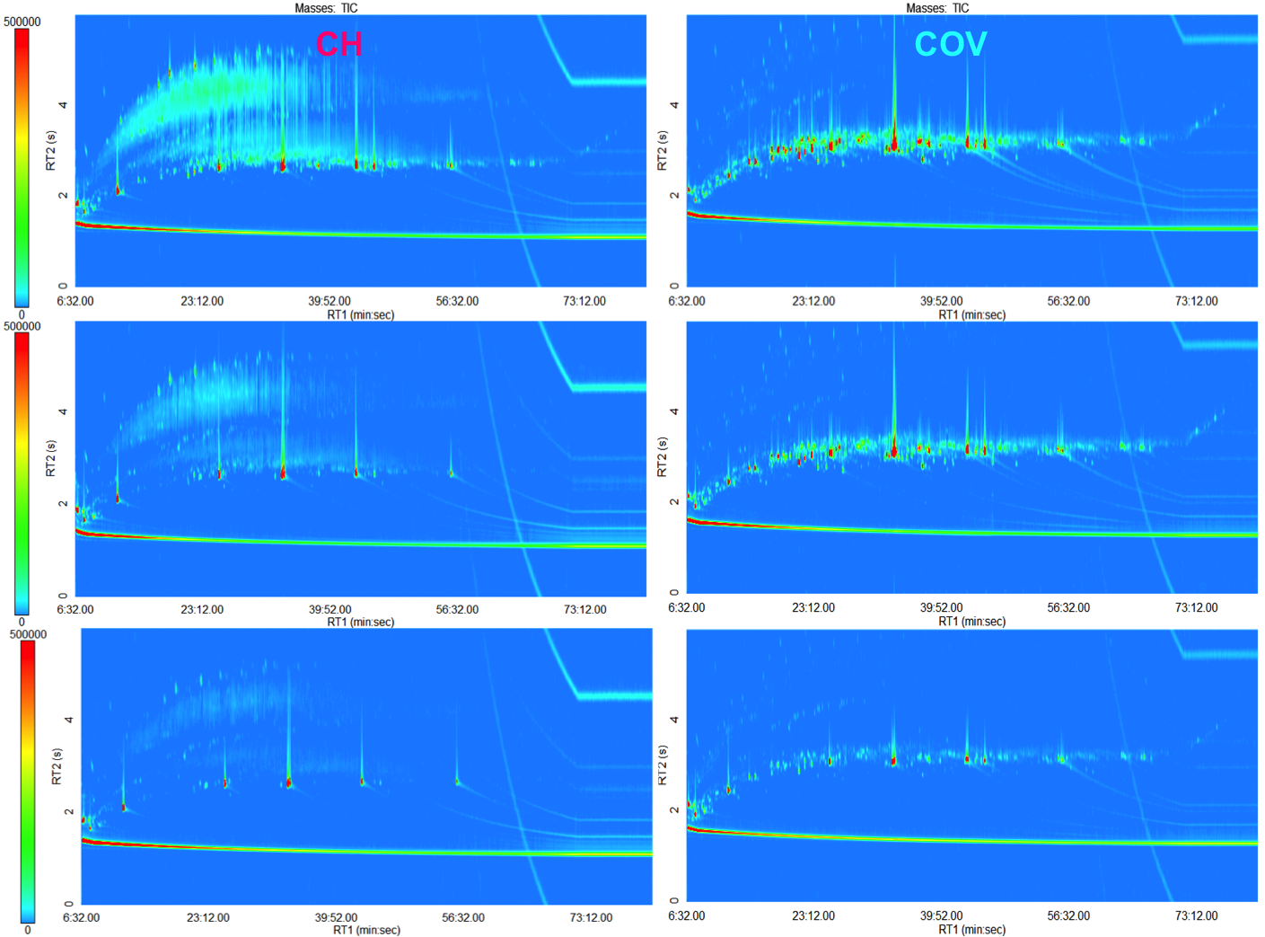
Tar
Microbial
Degradation

Slide 22
Tar
Microbial
Degradation

Slide 23
Tar
Microbial
Degradation
Operational Taxonomic Units

Slide 24
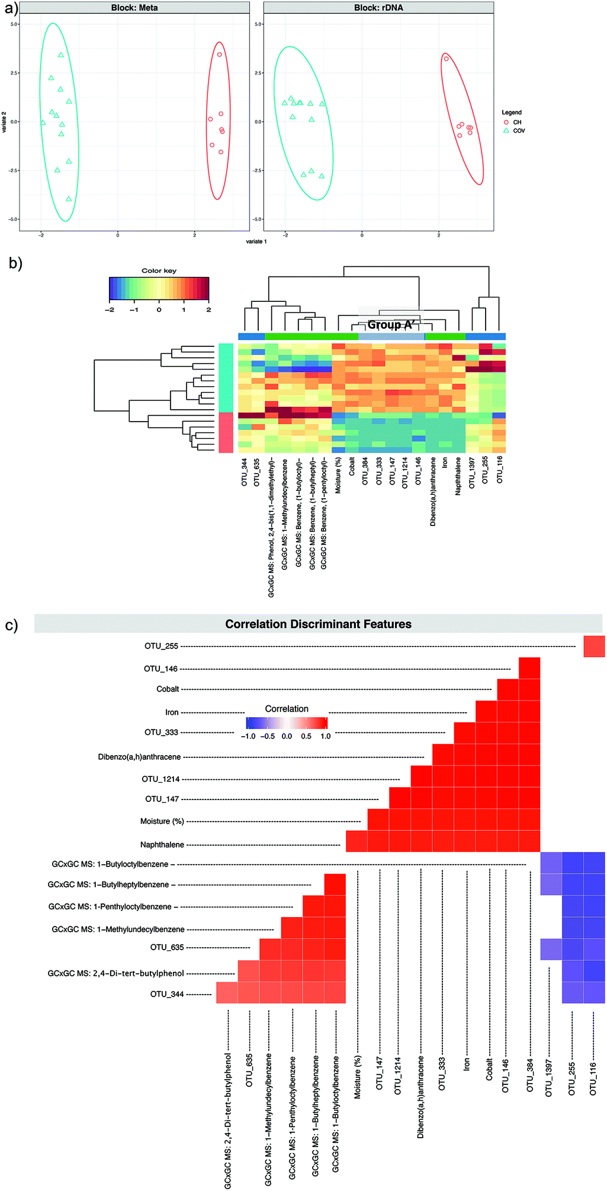
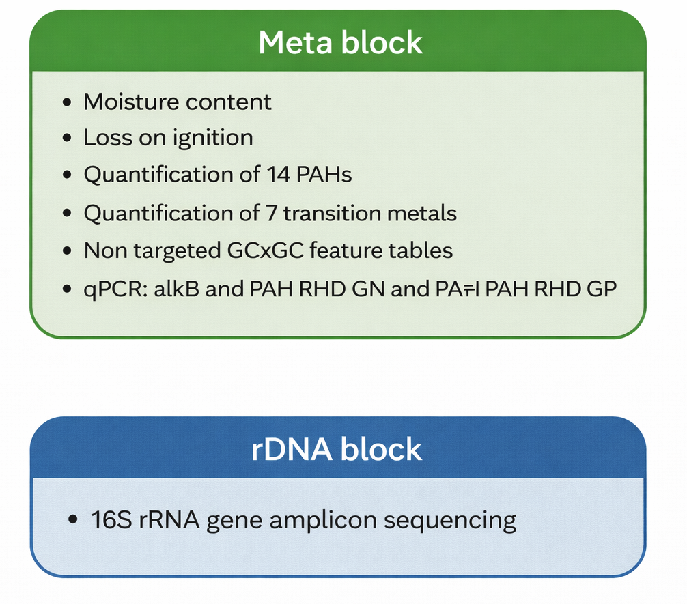
Tar
Microbial
Degradation
sPLS-DA /DIABLO
https://mixomics.org/
Notes:
It maximizes the covariance between latent components of different blocks and the outcome variable.

Slide 25
Tar
Microbial
Degradation
sPLS-DA /DIABLO
https://mixomics.org/
Notes:
It maximizes the covariance between latent components of different blocks and the outcome variable.

Slide 26
Tar
Microbial
Degradation
sPLS-DA /DIABLO
Gauchotte-Lindsay et al./Faraday Discussions (2019)
https://mixomics.org/
Notes:
It maximizes the covariance between latent components of different blocks and the outcome variable.

Slide 27
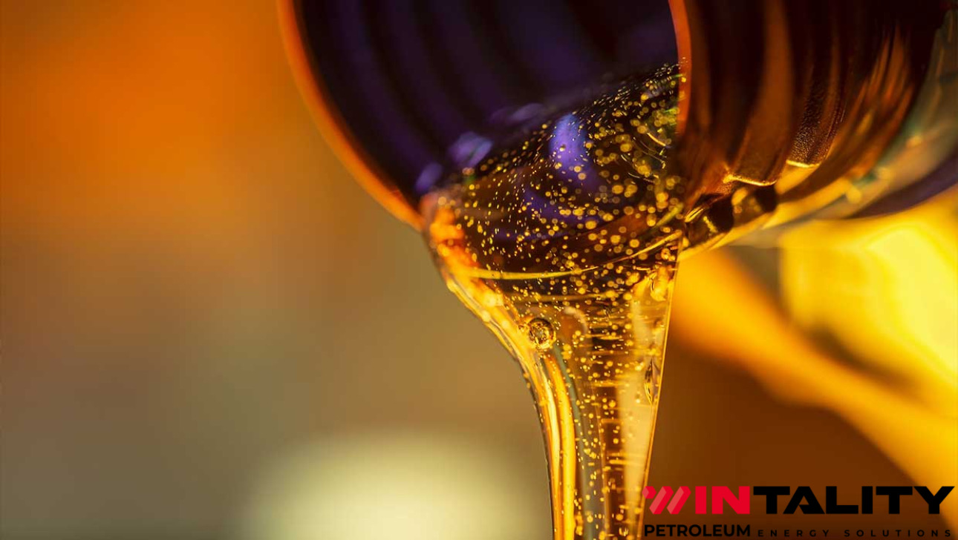
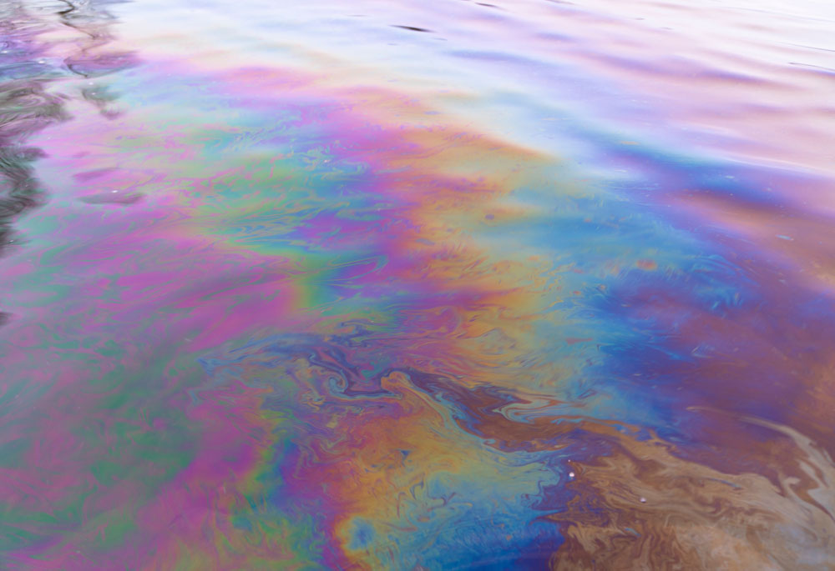
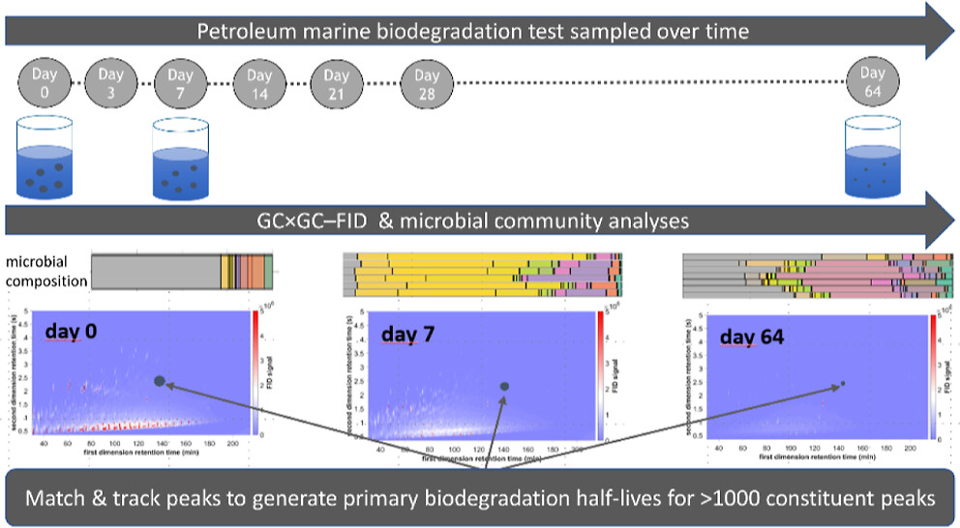
Sea water
Microbial
Degradation
Gas Oil
UVCB
unknown or variable composition, complex reaction products or biological materials
Booth et al./ES&T, 57 (2023)

Slide 28
From Description to Mechanistics
PCA

Slide 29
From Description to Mechanistics
PCA
Loading Plot

Slide 30
From Description to Mechanistics
PCA

Slide 31
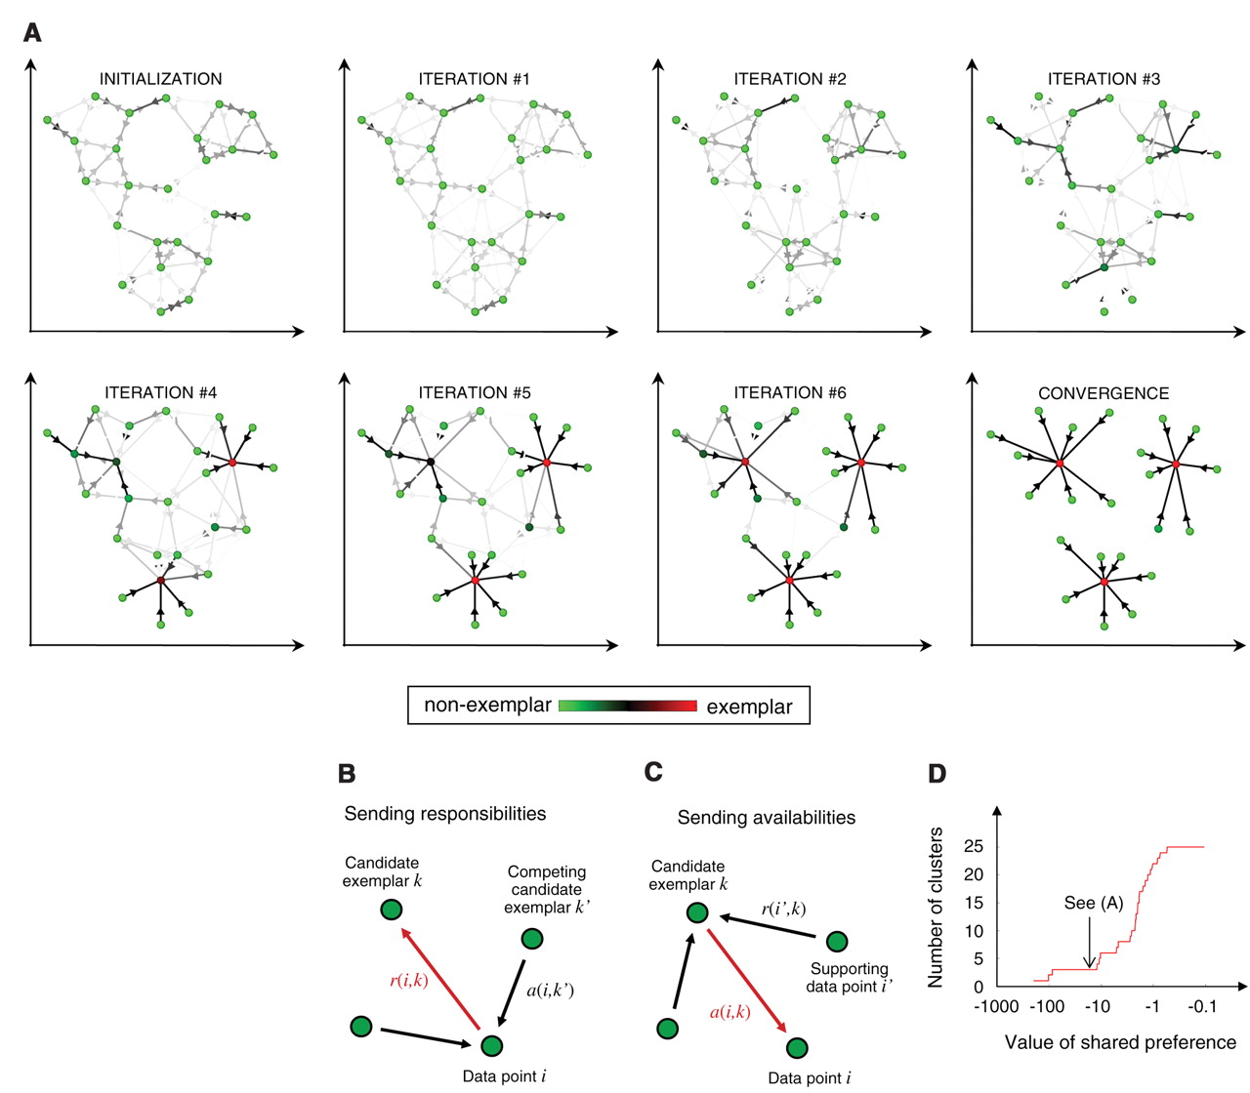
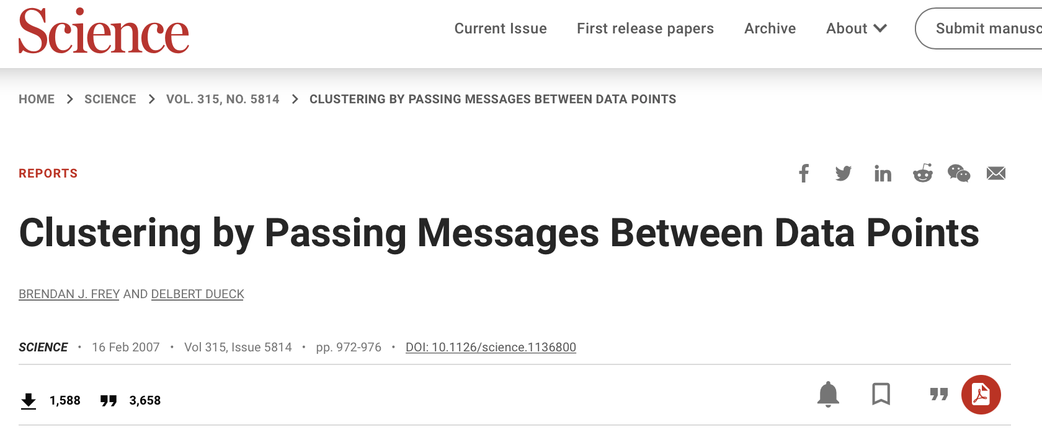
From Description to Mechanistics
Affinity propagation clustering
First
Mind switch!

Slide 32
Sea water
Microbial
Degradation
Gas Oil
UVCB
unknown or variable composition, complex reaction products or biological materials
Booth et al./ES&T, 57 (2023)

Slide 33
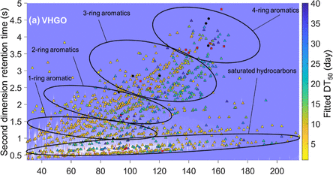
Sea water
Microbial
Degradation
Gas Oil
UVCB
Booth et al./ES&T, 57 (2023)

Slide 34
Sea water
Microbial
Degradation
Gas Oil
UVCB

Slide 35
Sea water
Microbial
Degradation
Gas Oil
UVCB

Slide 36
Sea water
Microbial
Degradation
Gas Oil
UVCB

Slide 37
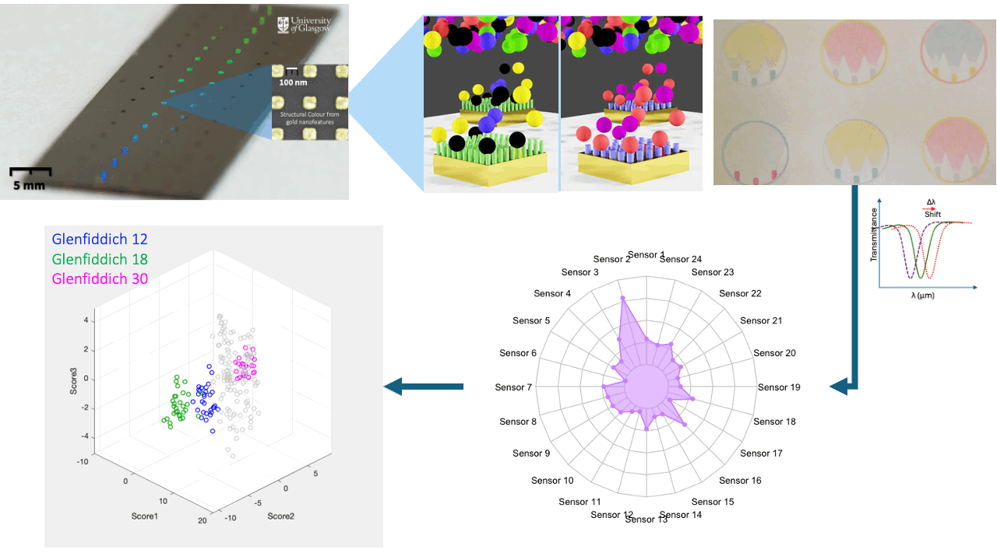
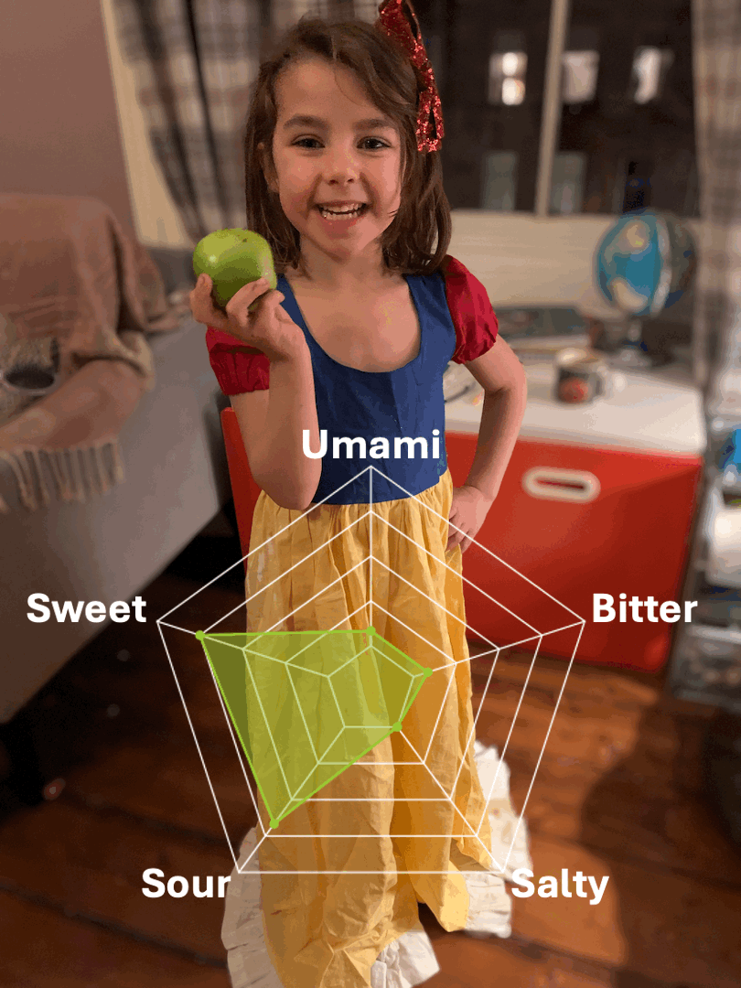
Optical Tongue
Sperling et al./ACS Sensor, 11 (2025)

Slide 38
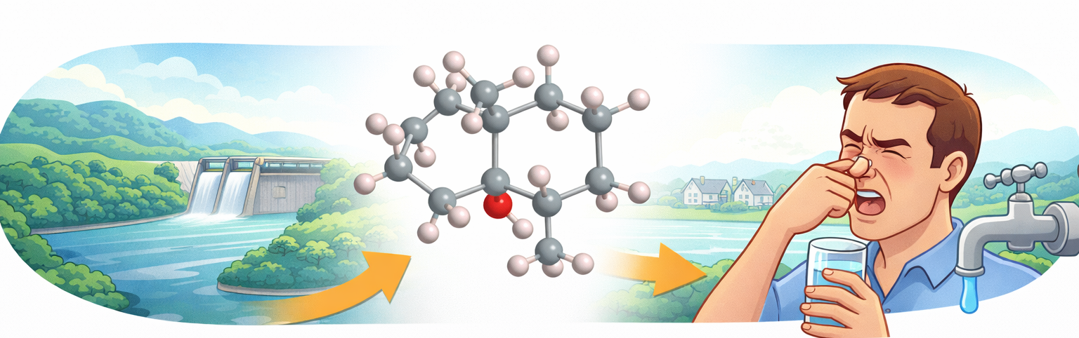
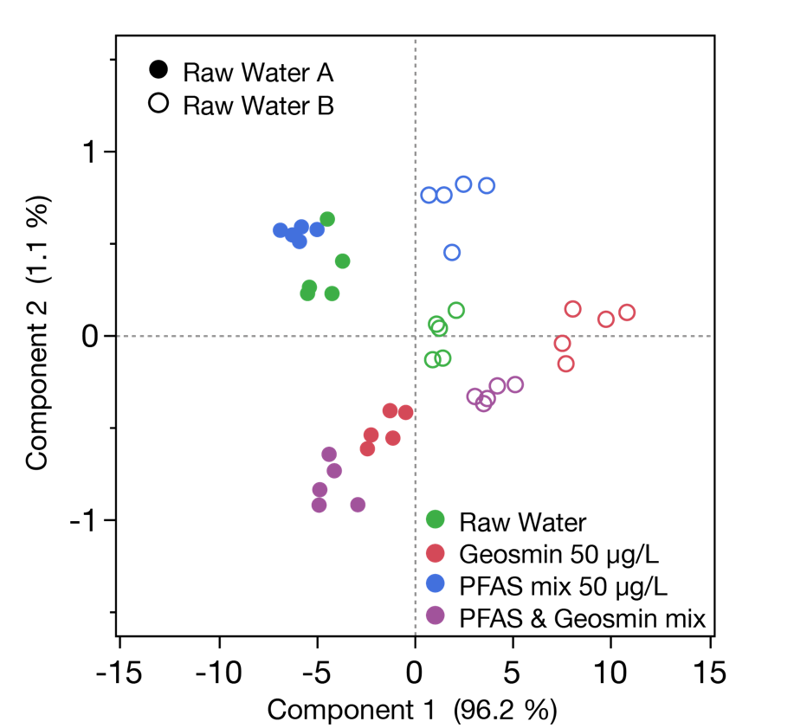
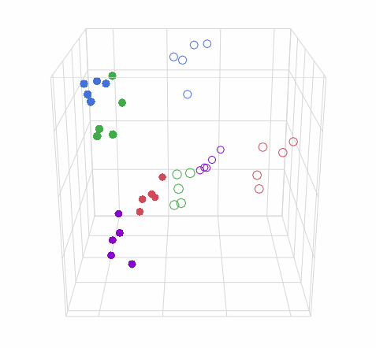
Spiked Samples
Sperling et al./Environ. Sci.: Nano. (2023)

Slide 39

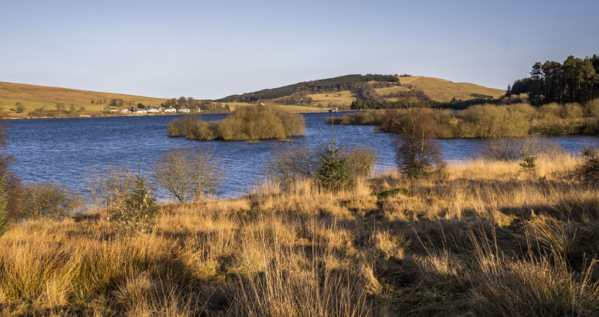
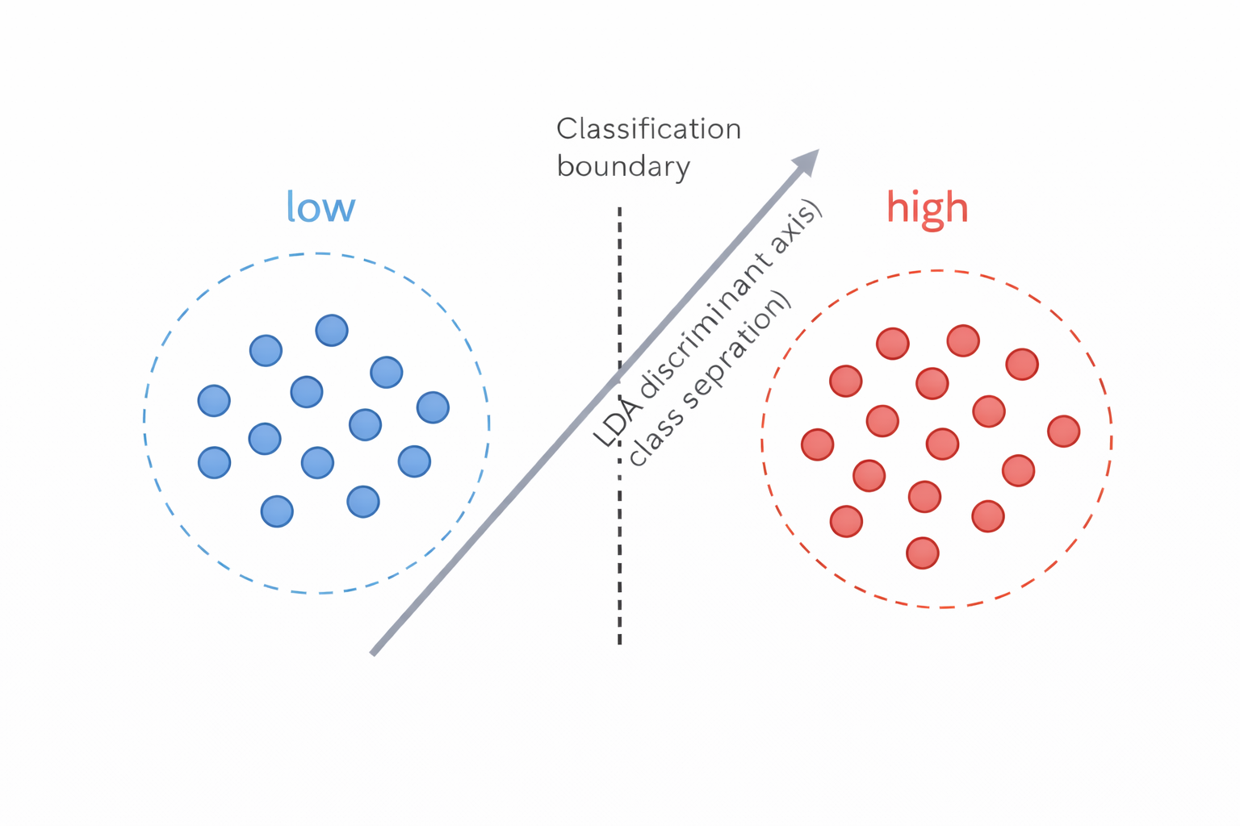
LDA
Carron Valley
Success rates for each day are high (>90% across the trial)
Drinking Water Treatment Plant Samples

Slide 40
Conclusions
Signature-based approaches capture the true complexity of environmental engineering systems and expose behaviours missed by targeted analyses
Combined with multivariate and machine-learning methods, signatures move analysis from description to mechanistic insight, prediction, and monitoring
This is a paradigm shift for analytical chemistry: rigour remains essential, but method validation and QA/QC must be reinvented for system-level signatures
By maximising information per sample, signature analysis aligns with green analytical chemistry, enabling more efficient, sustainable environmental monitoring and remediation
Remaining challenges: validation of multivariate signatures, transferability across systems, and translation into trusted operational tools
caroline.gauchotte-lindsay@glasgow.ac.uk

